Slide 1
MAT 350 Engineering Mathematics
Lecture -3A
First order Linear ODE and Modelling
Mohammad Sahadet Hossain, PhD
Professor
Department of Mathematics and Physics
North South University
mohammad.hossain@northsouth.edu

Slide 2
First-order differential equation: (Chapter 2.3) Linear differential equations:
A first-order differential equation of the form
(1)
is said to be a linear equation in the dependent variable y.
When g(x) = 0, the linear equation (1) is said to be homogeneous; otherwise, it is nonhomogeneous. The standard form, of the above linear equation
is
(2)
We seek a solution of (2) on an interval I for which both coefficient functions P and f are continuous.
If f(x)=0, one can solve (2) by variable separable method.

Slide 3
Linear differential equations:
(2)
When (2) is multiplied by a function μ (x), it becomes an exact differential equation. This function, μ (x) is known as integrating factor (I.F)
For a linear ODE (2) ; the integrating factor is given by
(3)
Multiply both sides of (2)

Slide 4
Integrating both sides w.r.t. x
Steps:
(i) Identify P(x) from the standard form (2)
(ii) Compute I.F. μ(x)
(iii) Multiply equation (2) with I.F and reduce to exact differential.
(iv) Solve for y

Slide 5





Linear differential equations
Solution: Comparing to the standard form (2), we see that P(x)= -3, and the integrating factor is
Then multiplying the given equation by this factor gives
Integrating both sides,

Slide 6
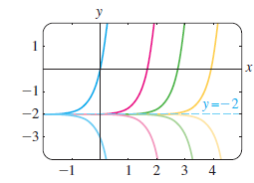

Linear differential equations:
y = y_{c} + y_{p}, where
y_{c} =ce^{3x} is the solution of the corresponding homogeneous eqn.,
And, y_{p}= -2 is a particular solution of the nonhomogeneous equation
0

Slide 7




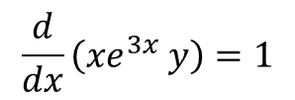

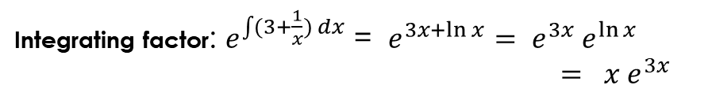
Prob#23, Exer#2.3
Solution (hints):
$\frac{dy}{dx}$+ (3+$\frac{1}{x})y=\frac{1}{x}e^{−3x}$
(1)
Integrating factor: $e^{\int{(3+\frac{1}{x}}) dx}$ = $e^{3x+\ln{x}}= e^{3x} e^{\ln{x}}$
$= {x e}^{3x}$
Multiply both sides of (1) with I. F and write as total differential form:
Hence, $\frac{d}{dx}\left({xe}^{3x} y\right)={x e}^{3x}$. $\frac{1}{x}e^{−3x}$
$$\frac{d}{dx}\left({xe}^{3x} y\right)=1$$
Integrating both sides,
$${xe}^{3x} y=x+c; c constant$$
General solution
$y=\frac{1}{{xe}^{3x}}$ ($x+c$) = $e^{−3x}+\frac{c}{{xe}^{3x}}$

Slide 8


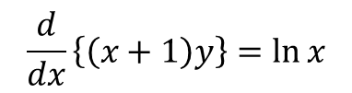

Prob-33, Exer#2.3
Integrating factor: $e^{\int{(\frac{1}{x+1}}) dx}$ = $e^{\ln{(x+1)}}=x+1$
Hence, $\frac{d}{dx}\left\{\left(x+1\right)y\right\}=\left(x+1\right). \frac{1}{(x+1)}\ln{x}$
$$\frac{d}{dx}\left\{\left(x+1\right)y\right\}=\ln{x}$$
Class work

Slide 9
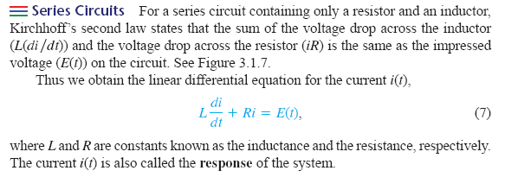
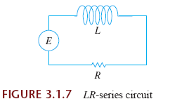
Modeling with Linear differential equations:
Circuit Model Problem
Mixture Problem
i

Slide 10








Solution: Hints
or,

Slide 11




Solution:

Slide 12


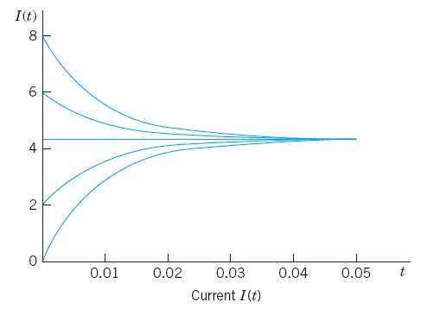
Model graph, not the exact one from the problem

Slide 13
If A(t) denotes the amount of salt (measured in pounds) in the tank at time t, then the rate at which A(t) changes is a net rate

Slide 14
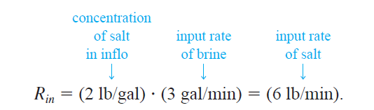
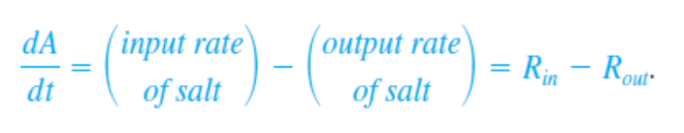
Let us suppose that a large mixing tank initially holds 300 gallons of brine. Another brine solution is pumped into the large tank at a rate of 3 gallons per minute; the concentration of the salt in this inflow is 2 pounds per gallon. When the solution in the tank is well stirred, it is pumped out at the same rate as the entering solution.
If 50 pounds of salt were dissolved initially in the 300 gallons, how much salt is in the tank after a long time?

Slide 15




SOLUTION (Hints)
Let A(t) denotes the amount of salt (measured in pounds) in the tank at time t. To find the amount of salt A(t) in the tank at time t, we solve the initial value problem
Integrating factor of the linear differential equation is
$$e^{100t}$$
Remark:
Over a long time the number of pounds of salt in the solution must be (300 gal)(2 lb/gal) 600 lb.

Slide 17
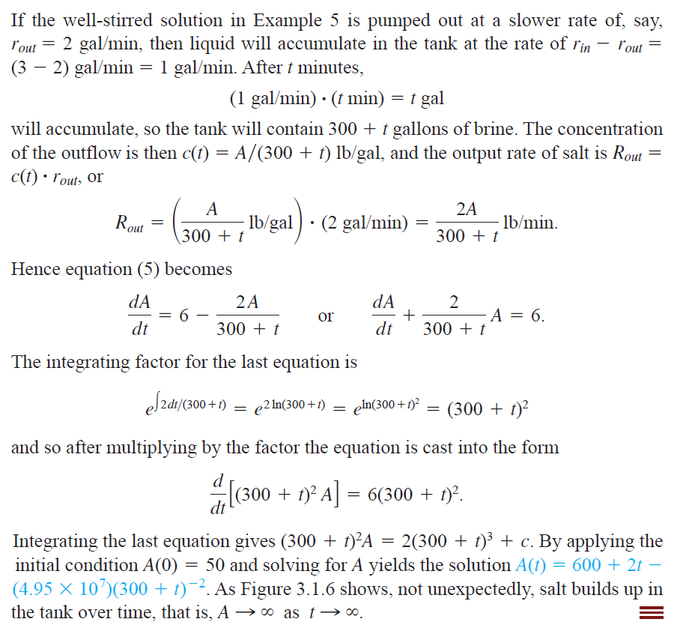
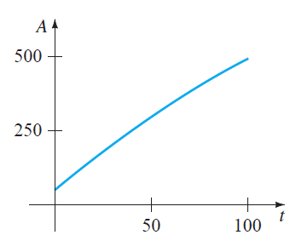
In last problem
Input and output rates
are NOT same
3 gal/min
2 gal/min

Slide 18



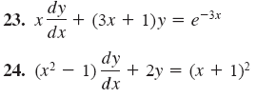
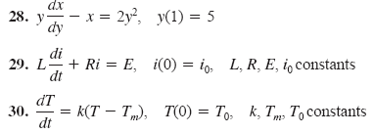
Exercises: 2.3
See Exercise sheet

Slide 19
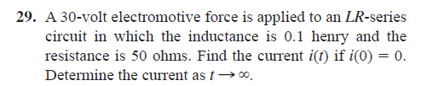
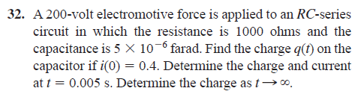
Modelling with first order linear ODEs
Exercise 3.1 (Zill)

Slide 21
End

